Slide 1
Decision Statements
CSC 101 – Introduction to Computer Science
Lecture 04
Department of
Computer Science and Engineering,
Independent University, Bangladesh

Slide 2
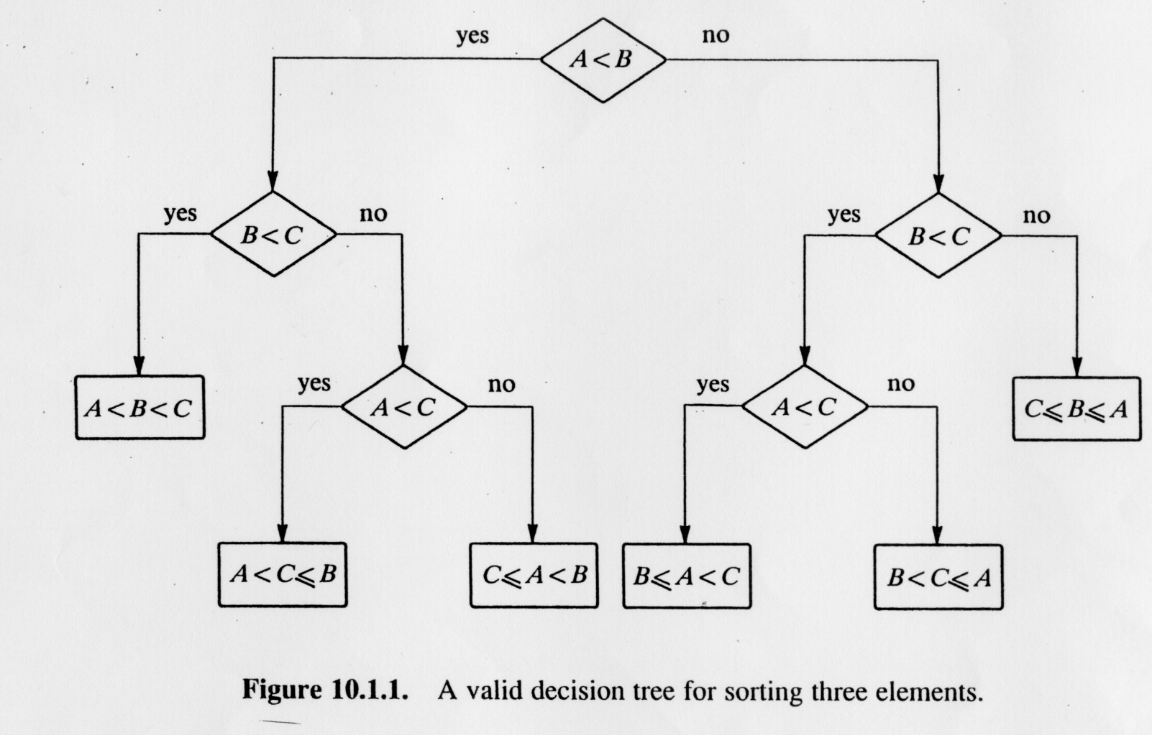
Sorting Three Integers: A, B
B is larger than A
A is larger than or equal to B

Slide 3
When if works, when if-else and if-elseif-else will not work: complex logic structure or nested if-else
Write a program in C++ that checks if a number is divisible by 5 and 7, or just 5 or 7 or neither.
Sample input | Sample output
12 | Not divisible by 5 or 7
35 | Divisible by 5 and 7
15 | Divisible by 5 not by 7
49 | Divisible by 7 not by 5

Slide 4
Sorting Three Integers: A, B, C

Slide 5
Today
if statement
if-else statement
if-else-if statement
Logical and Relational Expressions
  Operators
  Variables
  Short-circuit Evaluation

Slide 6
Can We Do These …
Given the APR and account balance on a credit card, compute time to pay-off with a monthly payment of $20
A program that reads in two numbers and tells the user which is the bigger of the two
A program that reads in two numbers and performs an arithmetic operation on those two numbers and displays the result
Given location of classes and distance between buildings find a schedule for Spring that minimizes walking time
No!
Yes, if it’s always the same operation
No!

Slide 7
Can We Solve The Following?
Given the distance between two people, determine the number of steps they need to take to meet at a point in the middle
Each step cuts the distance between them in half
Zeno’s paradox
Limits of computability : The halting problem
Limits of computability :
P = NP ?

Slide 8
Can We Do The Following?
Write a program that always wins at rock-paper-scissors?
Some researchers claim we can if we play 20 rounds
Use AI to predict what the human will do

Slide 9
Decisions in Algorithms
Any algorithm is a sequence of instructions
However, certain instructions are to be followed only if a particular condition holds
  When water comes to a boil remove pot
  If in an emergency take stairs
  Turn key if car is in park and foot on brake
  If hungry and not bored then eat

Slide 10
Decisions in Algorithms
Any algorithm is a sequence of instructions
However, certain instructions are to be followed only if a particular condition holds
  When water comes to a boil remove pot
  If in an emergency take stairs
  Turn key if car is in park and foot on brake
  If hungry and not bored then eat

Slide 11
Decisions in Algorithms
To implement any useful algorithm we need a mechanism that allows us to
  Represent conditions or states or events in a program
  Execute certain instruction based on the outcome of the conditions or states or events
So far, all the programs we have looked at executes every statement in the program

Slide 12
Representing Conditions and Events
Conditions and events in a C++ program are represented using logical expressions
  these expressions have the value true or false
  we use relational operators to create logical expressions
Example
temp >= 100 // can represent boiling water
trans == ‘P’ // can represent car in park
input == ‘d’ // d for division

Slide 13
Example : Simple Logical Expressions
Logical expressions with literals
    12 > 5 is true
    7 <= 5 is false
Logical expressions with variables
  Assuming x has value 10
    x == 10 is true
    x != 8 is true
    x == 8 is false

Slide 14
Relational Operators
> | Greater than
< | Less than
If (x>=y) | Greater than or equal to
<= | Less than or equal to
== | Equal to
!= | Not equal to

Slide 15
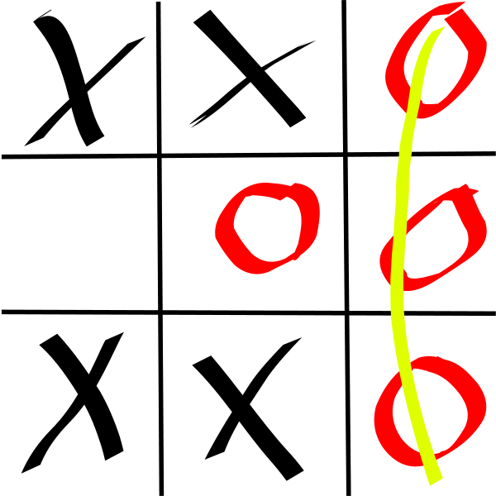
Tic-Tac-Toe Decisions
What are some of the conditions you may need if you are writing a program to play tic-tac-toe?
  opponent has made a move
  no more squares left
  opponent has two pieces in a column, row or diagonal

Slide 16
The if Statement
Allows statements to be conditionally executed or skipped over
Syntax models the way we mentally evaluate situations

Slide 17
The if Statement Syntax
  if (expression)
  statement;
DO NOT place ; after (expression)
place statement; on a separate line after (expression), indented
example
  if (score > 90)
  grade = 'A';
Notes:
What goes inside () … literal? variable? Is variable an expression?
What kind of statement can we have : how many types of statements do we know about

Slide 18
The if Statement Semantics
        statement0; _x0001__x0001_
        if (expression)
        statement1;
        statement2;
If expression is true, then statement1 is executed.
If expression is false, then statement1 is skipped.
if statement does not have any effect on the execution of statement0 or statement2
demo

Slide 19
The if Statement Semantics
Note, the condition only applies to the next statement
  if (expression)
  statement;
To apply the condition to multiple statements we need to enclose them in braces { }
  if (expression) {
  statement1;
  statement2;
  }

Slide 20
if Statement Controlling Multiple Statements
  if (score > 90){
  grade = 'A';
  cout << "Good Job" << endl;
  }
The curly braces creates a block of code, anywhere they are used

Slide 21
The if Statement : Caveat 1
What gets displayed on screen?
  int x;
    x = 13;
    if (0)
    x = 17;
    cout << x << endl;
    cout << x << endl;
Indentation is important
STYLE

Slide 22
The if Statement : Caveat 2
        char babyGender;
        cin >> babyGender; _x0001__x0001_
        if (babyGender == 'M')
        cout << "It’s a boy!" << endl;
        cout << "It’s a girl!" << endl;

Slide 23
The if-else Statement
Provides two possible paths of execution
Executes one statement (or block) if the expression is true, otherwise executes another statement (or block)

Slide 24
Using the else clause
The else clause is very useful when you want to a perform one task for a specific item and do something else for all other items
  if student is favorites student assign grade of A
  for everyone else assign grade based on performance
  if user enters + then do an add, if user enters – then do a subtract
  for everything else say, “can’t handle that operation”

Slide 25
The if-else Statement : Syntax
        if (expression)
        statement1;
        else
        statement2;
Note the indentation
Note the
semi-colons

Slide 26
The if-else Statement: Semantics
        statement0;
        if (expression)
        statement1;
        else
        statement2;
        statement3;
If the expression is true, then statement1 is executed and statement2 is skipped
If the expression is false, then statement1 is skipped and statement2 is executed
if-else statement does not have any effect on the execution of statement0 or statement3
demo

Slide 27
Variables for Logical Expressions
The values of a logical expression can be stored in a variable
result = x == y;
Assigns 0 for false, 1 for true
Remember and note the difference between = and = =

Slide 28
Variables for Logical Expressions
Variables that hold logical values are usually declared as bool
As with other variables, should be assigned an initial value before it is used
The value assigned is an expression that evaluates to true or false
      bool rainedToday = false;
      bool getsMoreThanMinWage = wage > 6;

Slide 29
Logical Operators
In many situations we may want to test multiple conditions
We can use logical operators to combine logical expressions and logical values
hasCar && canDrive && licenseValid
!rainedToday
(7 > 3) && true
false || true

Slide 30
Logical Operators
&& | AND | New relational expression is true if both expressions are true. Binary operator
|| | OR | New relational expression is true if either expression is true. Binary operator
! | NOT | Reverses the value of an expression – true expression becomes false, and false becomes true. Unary operator

Slide 31
Logical Operators : Examples
int x = 12, y = 5, z = -4;
(x > y) && (y > z)
(x > y) && (z > y)
(x <= z) || (y == z)
(x <= z) || (y != z)
!(x >= z)

Slide 32
Logical Operators : Examples
int x = 12, y = 5, z = -4;
(x > y) && (y > z) | true
(x > y) && (z > y) | false
(x <= z) || (y == z) | false
(x <= z) || (y != z) | true
!(x >= z) | false

Slide 33
Logical Operators Precedence
! has highest precedence, followed by &&, then ||
!
&&
||
Always use parentheses if you are unsure about precedence

Slide 34
Logical Expression Caveat
Be careful testing floats and doubles for equality
0 is false; any other value is true

Slide 35
Short-circuit Evaluation
If the value of an expression can be determined by evaluating just the sub-expression on the left hand side of a logical operator, then the sub-expression on the right will not be evaluated
7 > 3 || what_ever_goes_here
Efficient execution
Useful for programming as well

Slide 36
Short-circuit Evaluation
What can we say if the left operand of the && operator is false?
  The combined expression is false
What can we say if the left operand of the || operator is false?
  Nothing!
  If the left operand of the || operator is true then the combined expression is true

Slide 37
Example
Determine the number of pizzas to order for a party given the expected number of guests and expected number of slices each person will consume

Slide 38
The if-else-if Statement
Chain of if statements that test in order until one is found to be true
Also models thought processes:
  “If it is raining, take an umbrella,
  else, if it is windy, take a hat,
  else, take sunglasses …”

Slide 39
if-else-if : Syntax
  if (expression)
  statement1;
  else if (expression)
  statement2;
  .
  .
  .
  else if (expression)
  statementX;

Slide 40
Using a Trailing else
Used with the if-else-if statement when none of the expressions are true
Provides default statement or action
Used to catch invalid values, other exceptional situations

